Slide 1
UAVs to Capture Data for Riparian Research
By Jim Graham, Jordan Adair, Erik Kenas
Humboldt State University

Slide 2
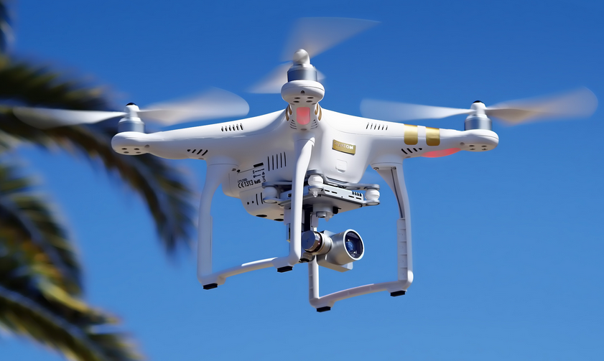
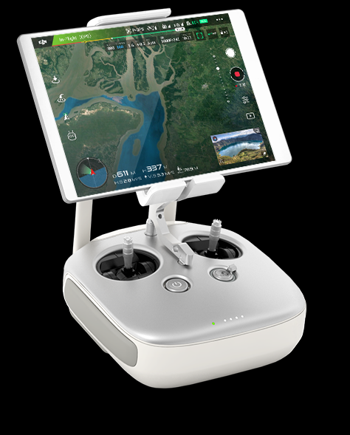
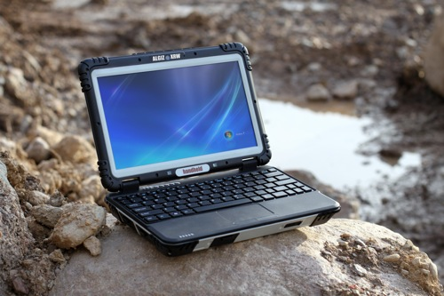
Definitions
Drone/Unmanned Aerial Vehicle/UAV
Radio Control/RC with
Mobile Device
(Ground Station)
www.thynkdrones.com
Mobile
Computer
Unmanned Aerial System (UAS)
Notes:
UAV w/sensors

Slide 3
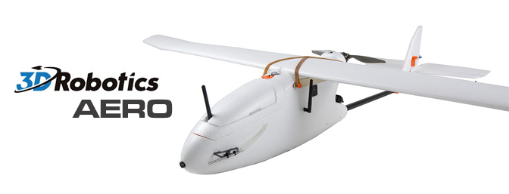
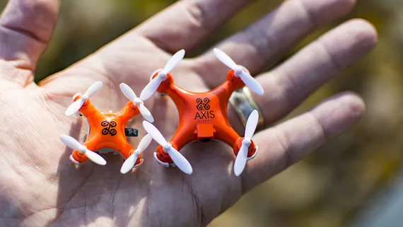
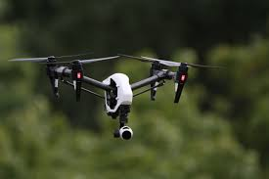
Fixed Wings: Long flights, heavier payloads
Rotors (copters): Easier to fly and land

Slide 4
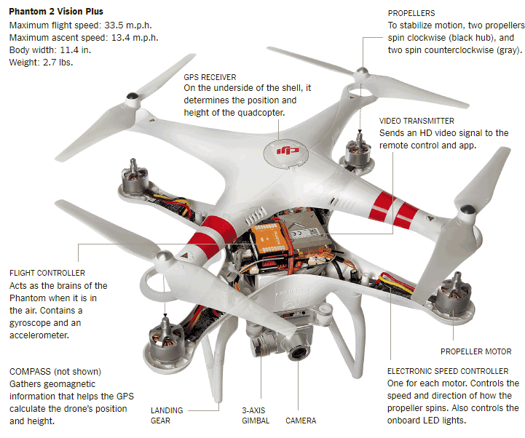
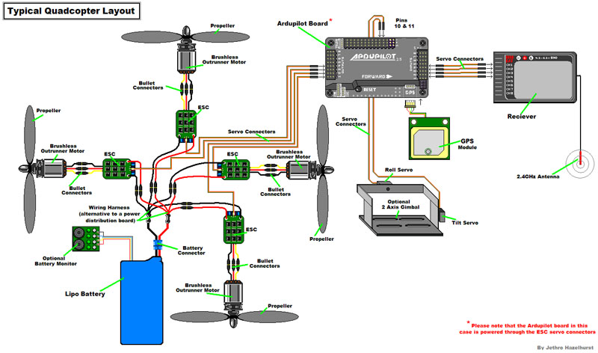
https://www.nytimes.com
Notes:
Sensor is missing

Slide 5
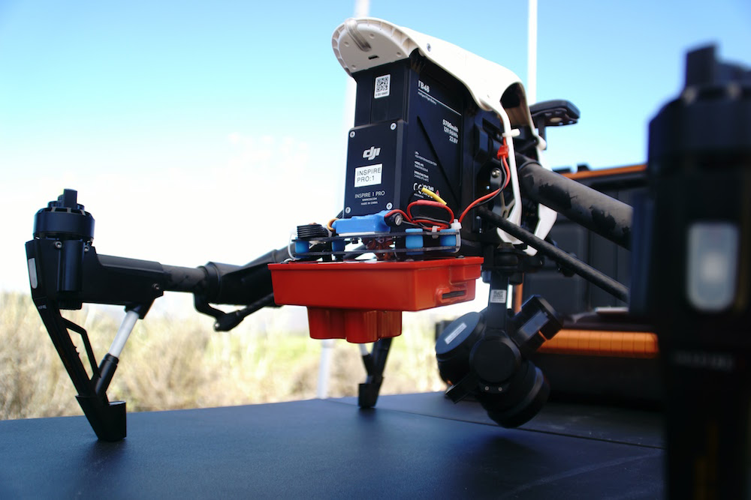
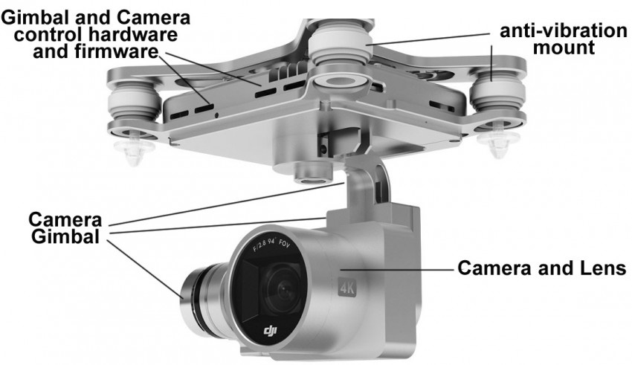
RedEdge sensor mounted for surveying
Typical camera mount for video capture

Slide 6
The Equipment
A UAV
  Extra props
  Controller
  Lots of batteries
  Charging cables, gang charger
  Case/backpack
Landing pad
Computer
Flash cards
UAV utility software
Flight control software
Structure for Motion Software
Sun tan lotion
First aid kit
Water
Etc.

Slide 7
What you Need to Fly For Research AT HSU
FAA Remote Pilot Certificate
Approved HSU Research Plan
HSU Flight Certificate (in the works)
Or
  Someone else that has these things
And permission from land owner
Notes:
There are a lot of other restrictions

Slide 8
Potential Advantages
800 TeraPixels to
80 PetaPixels
UAV Surveys
10 to 1 cm
Aerial Surveys
~1 meter
8 TeraPixels
80 GigaPixels
DEMs
10 meter
8 GigaPixels
LandSat
30 meter
Whole World
Twice a month
CONUS
Once
CONUS
Every few years
10 Hectares per hour
Notes:
CONUS=8,000,000 square km
Vertical axis is data size for CONUS

Slide 9
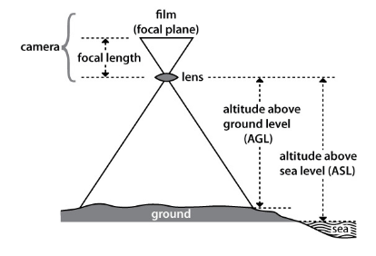
http://www.nrcan.gc.ca

Slide 10
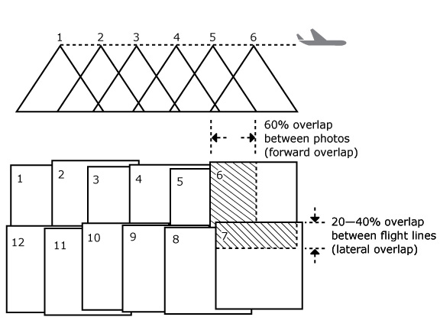
mining.com
http://www.nrcan.gc.ca

Slide 11
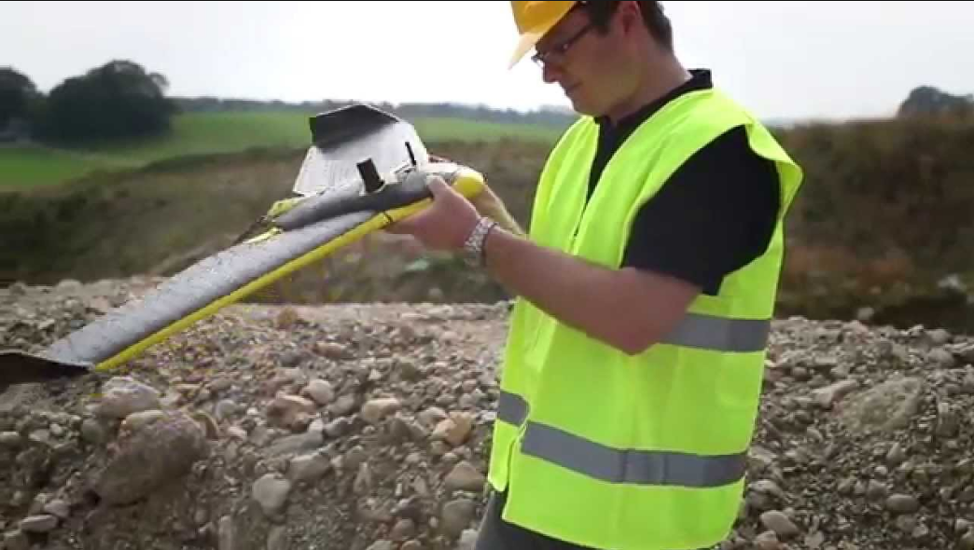

Platform: SenseFly eBee RTK
Flown by: Vertical Sciences
Notes:
Early work contracting another organization

Slide 12
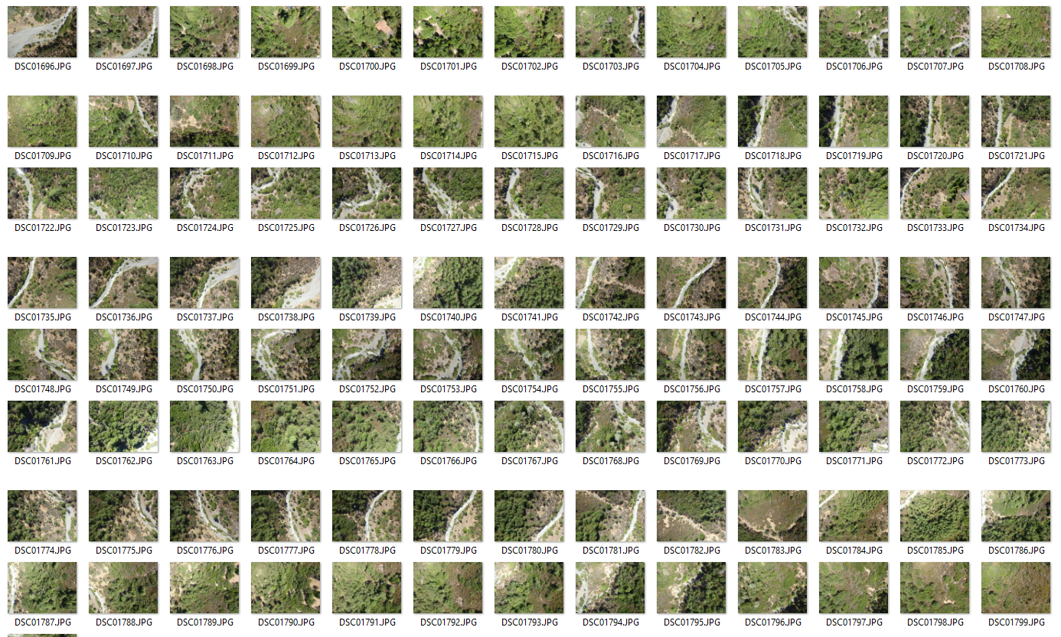
204 Digital Images
~3 cm resolution

Slide 13
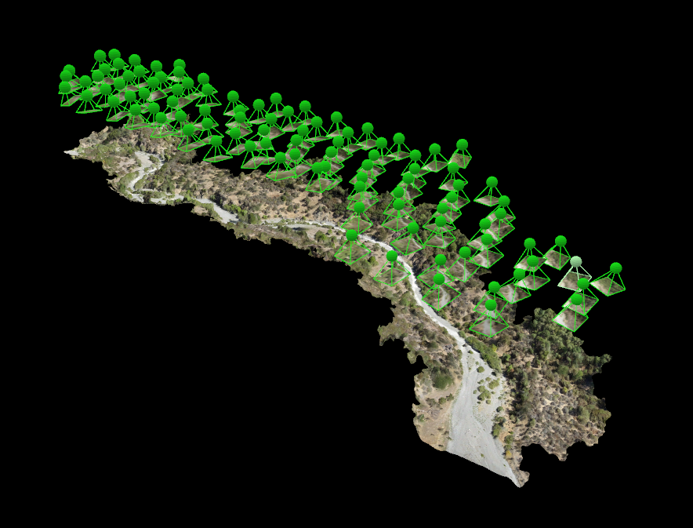
Structure for Motion in Pix4D

Slide 14
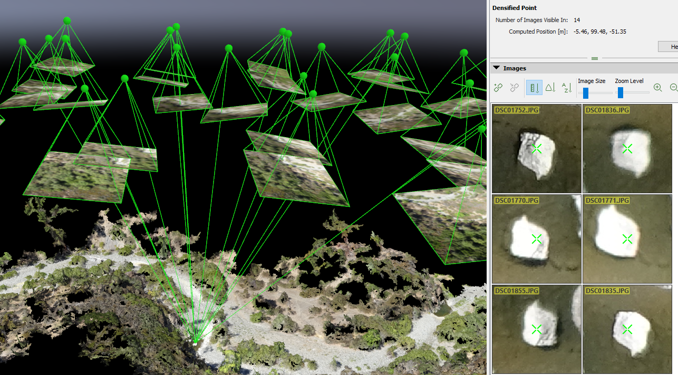
Structure From Motion in Pix4D

Slide 15
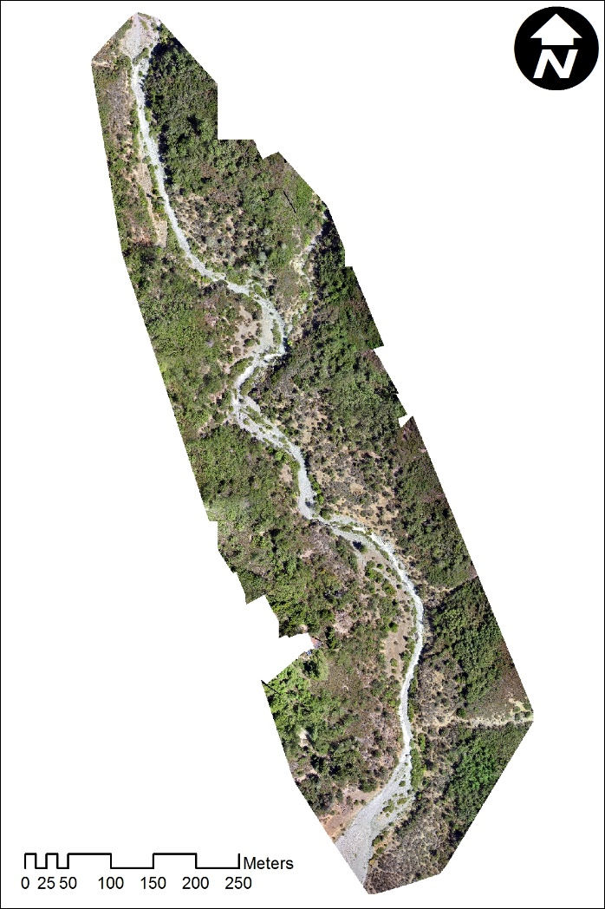
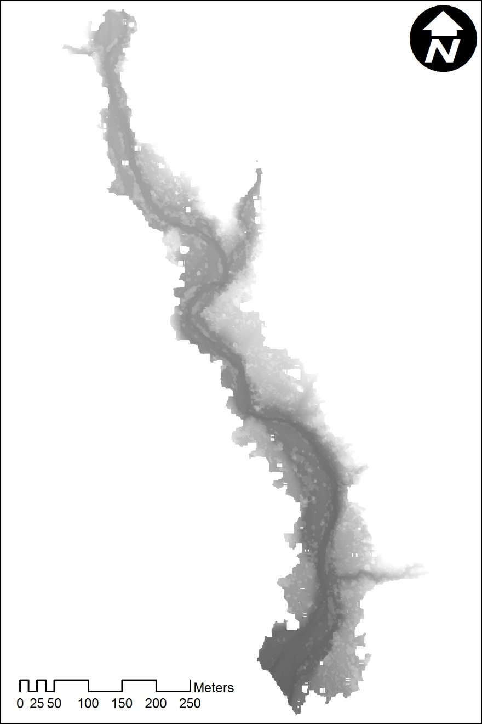

Slide 16
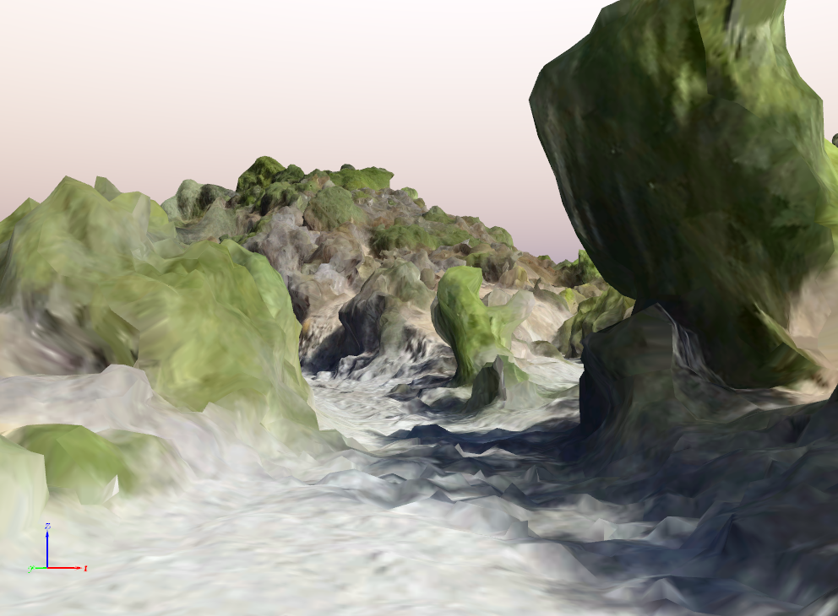
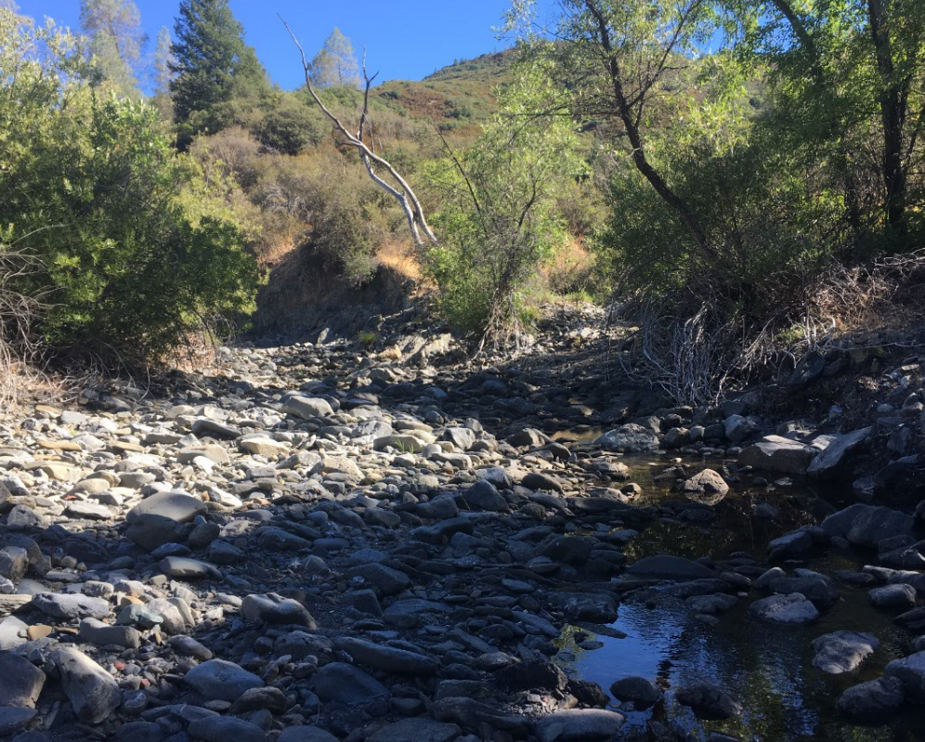

Slide 17
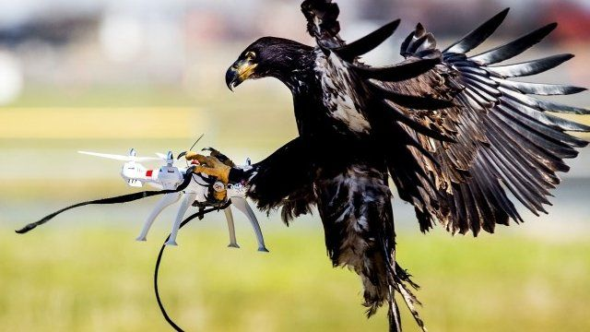
Learnings
Bbc.com
Issues:
  It took 6 months to get the data from Vertical Solutions
  The area flown did not match the ground-truthing
Learnings
  HSU needs to be in control of their UAV flights and data
  Processing was relatively easy
  Costs less than one survey to get started ourselves
    UAV: $1500
    Control Software: Free to $10
    Processing Software: $700
    Time: $12 to $50 per hour

Slide 18
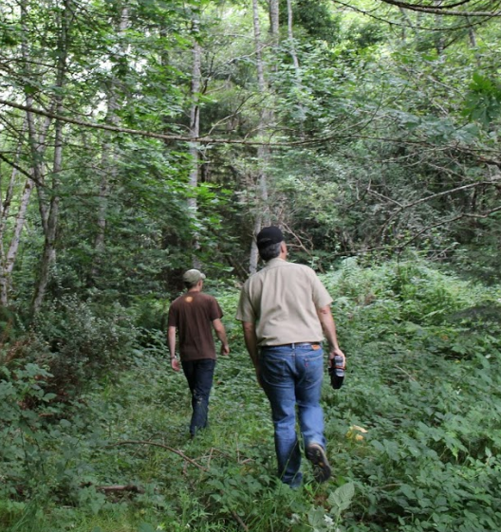
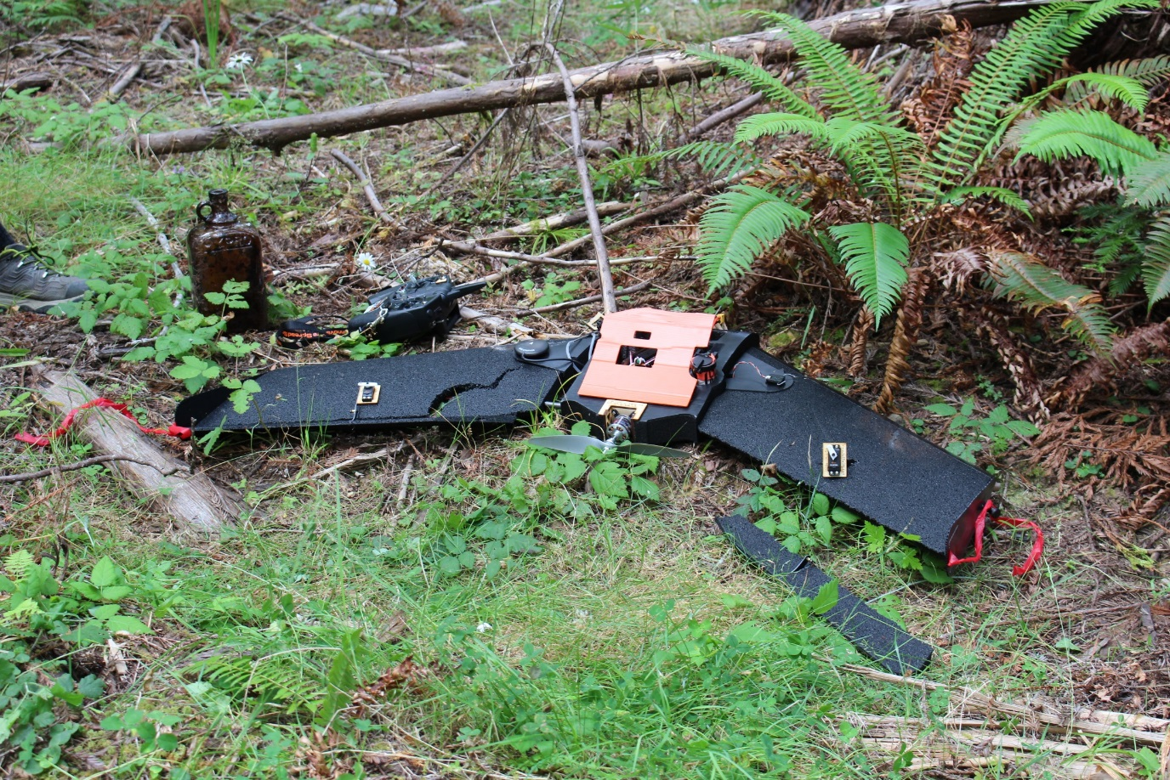
More Learning
Fixed wing UAVs are harder to fly (and land)
Over 100 DJI Rotary flights without damage
Need to add VHF transmitters to UAVs

Slide 19
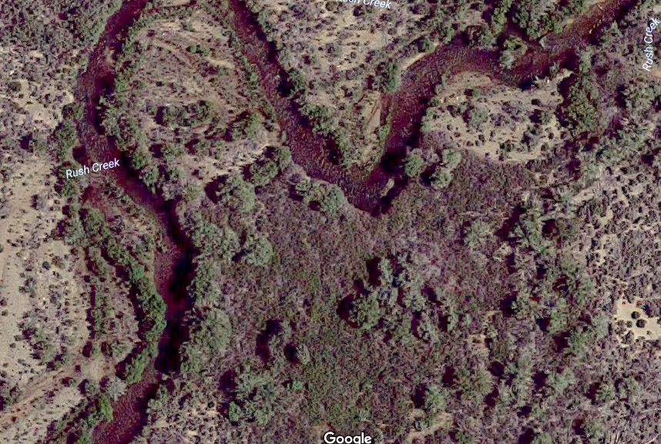
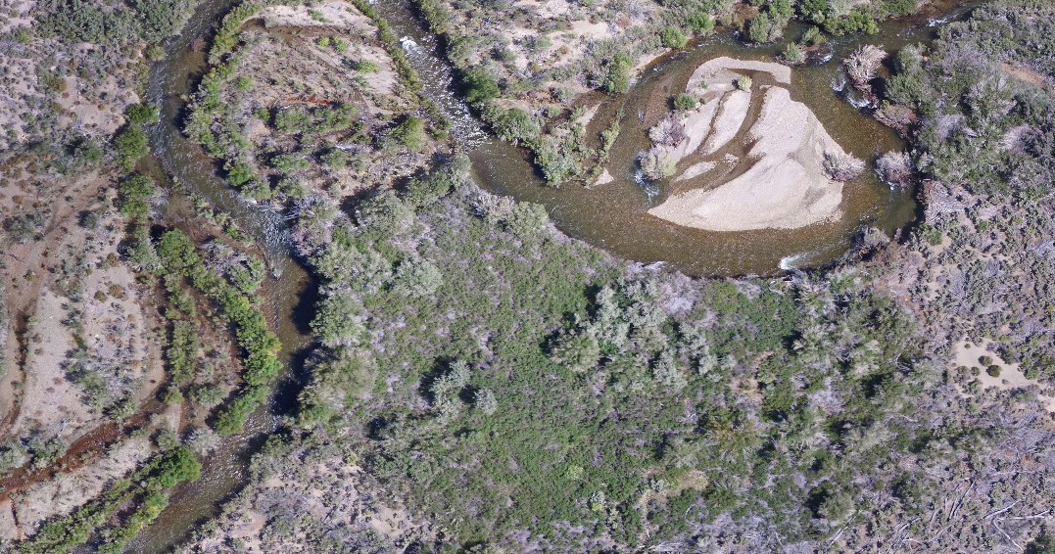
GoogleMaps
Phantom 3
RGB higher resolution

Slide 20
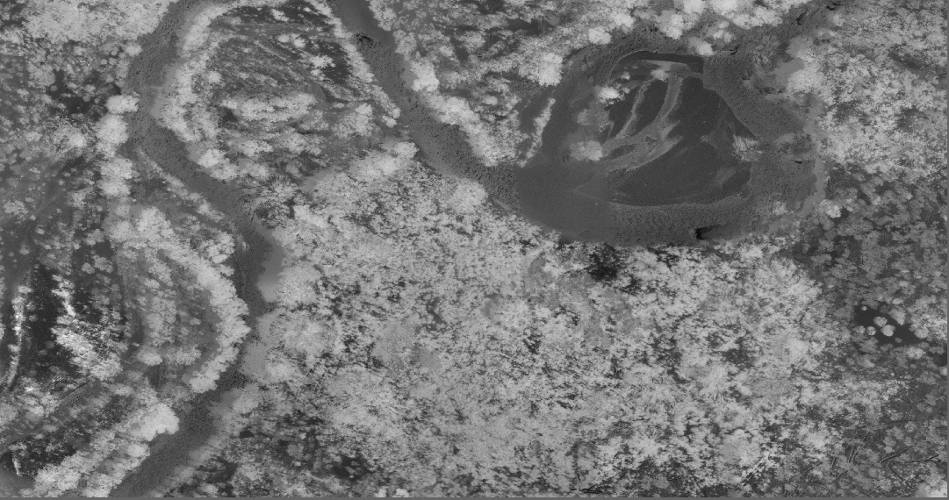
RedEdge
Phantom 3
RGB higher resolution

Slide 21
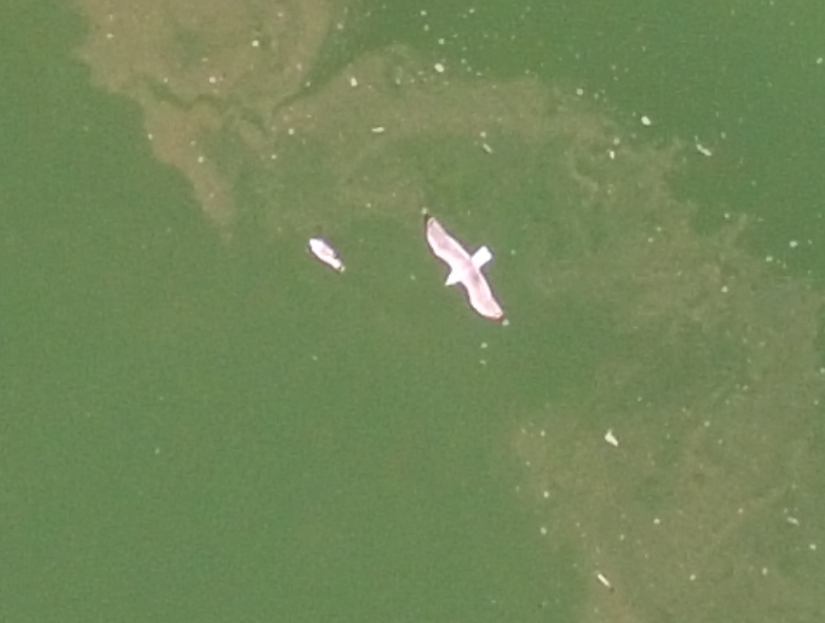
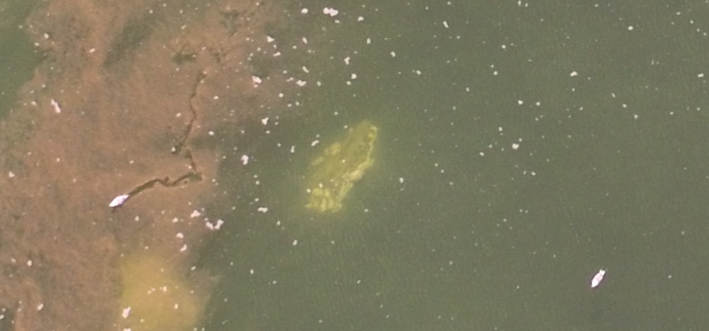
Phantom 3
Gulls

Slide 22
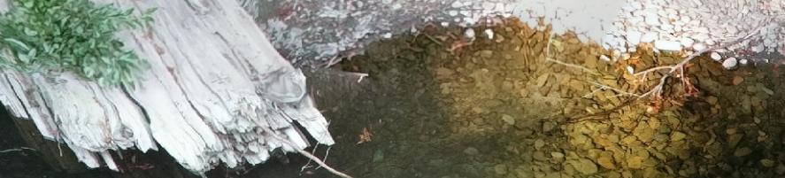
Additional Results
Eel River Test Flights
Takes 15 minutes per flight but 15-30 minutes total
  Setup: planning mission, setting up landing site, setting up UAV, checking everything, dealing with problems
  Tear-down: off-loading data, packing up the UAV, dealing with problems
Mission control software has issues

Slide 23
Discussion - UAVs
It is easy to learn to fly DJI rotary UAVs but there are a lot of components and failures are common
Flying fixed-wing UAVs is more complicated and landings require larger areas than rotary UAVs
Sun angle and smoke are issues
Wind does not impact the DJIs much and makes flying more exciting
Bbc.com

Slide 24
Discussion - DATA
Rotary UAS can provide very high resolution (1 meter to 1 cm) at very low cost for small areas
  Both visual (RGB) and IR
UAS can create elevation maps that appear high in precision and accuracy
UAS can be inexpensive and flown when needed
As canopies close and lower, it is harder to fly UAVs
UAS fits between aerial photography and field surveys for natural research and management

Slide 25
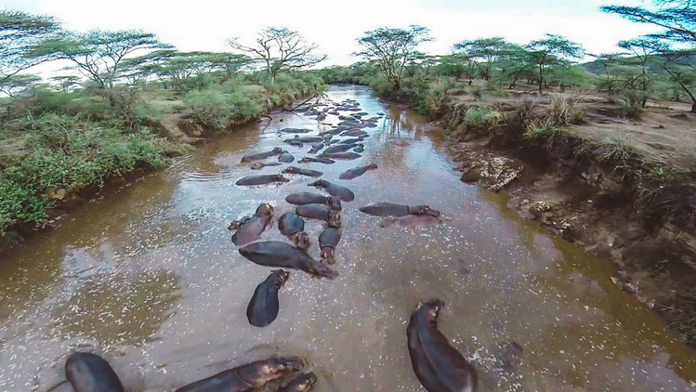
CONCLUSIONS
offgridquest.com
UAS is already playing an important role in natural resource research and HSU and will increase in important in natural resource management.
UAS can provide high resolution, high frequency data for riparian systems.
HSU should begin a training program for students and personnel in the use of UAS.
  Advanced remote sensing: processing UAV data
  New online course for ground school
  Summer class for pilot training
  “Check out” UAS from Forestry Stockroom?

Slide 26
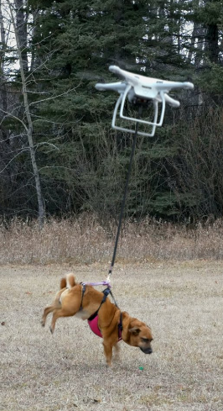
Next Steps
Can we collect LiDAR from an “inexpensive” UAV?
  Allows us to collect elevation data for closed canopies
Can automation improve the riparian UAV data?
How accurate is the UAV data?

Slide 27
Acknowledgements
Erik Kenas and Chris Muhl – the HSU pioneers in UAVs and still helping us out
Dave Marshall, Tim Bean, Dan Barton - faculty
Sara Mathews, Monique Crossman, Ethan Lukens, Justin Bissell – graduate students
Susan Brater – helps with UAV plans
Steve Karp, Rhea Williamson, Denise Helwig and the entire UAS review committee
Dean Boone, Steve Martin, Alison O’Down, Bill Trush – for support
LA Dept. of Water and Power, UC Davis, CA Water Resources Board – our funders
The nice folks at the FAA
King Schools – ground school

Slide 28
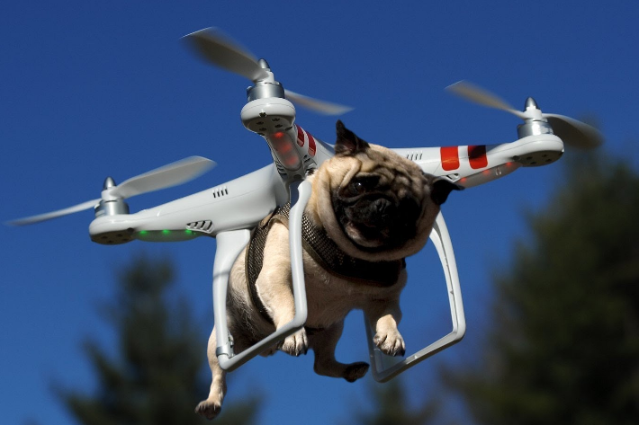
Questions?
Drone Fails

